Slide 1


Slide 2
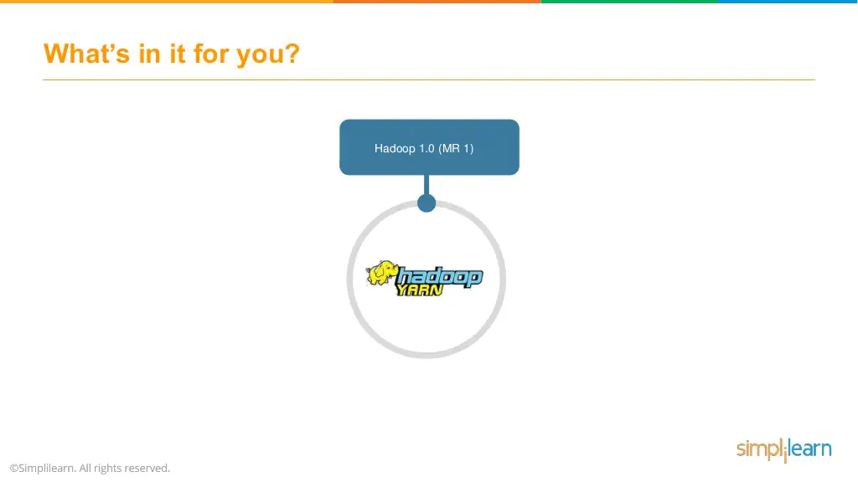

Slide 3
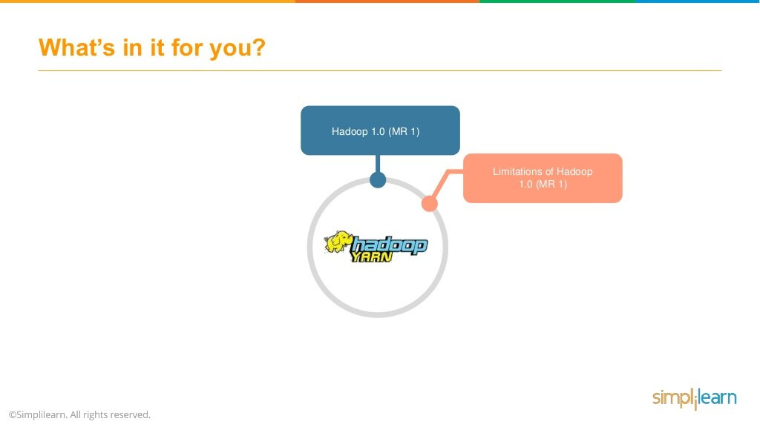

Slide 4
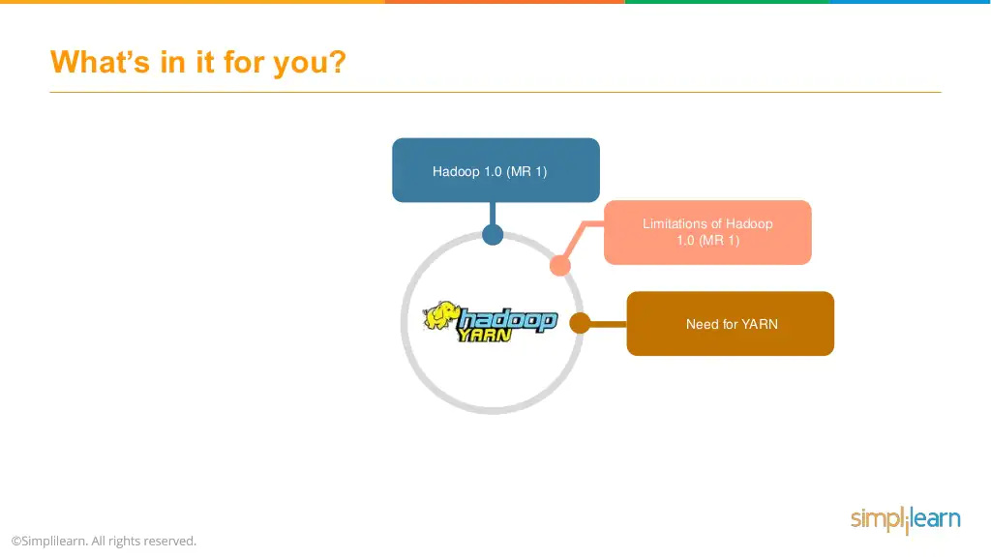

Slide 5
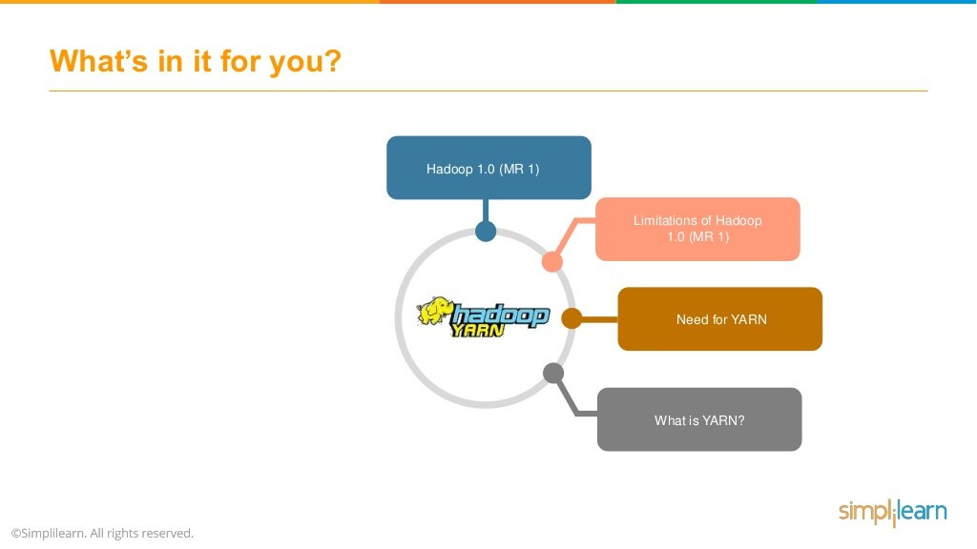

Slide 6
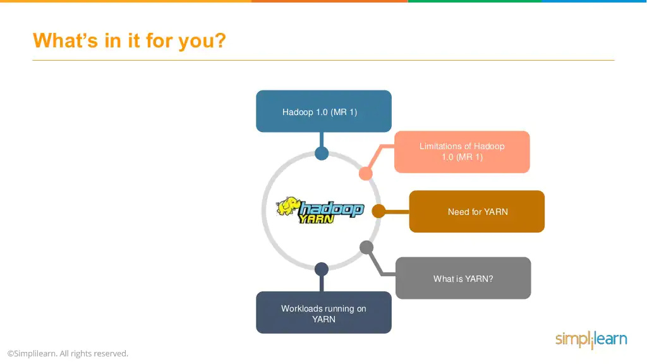

Slide 7
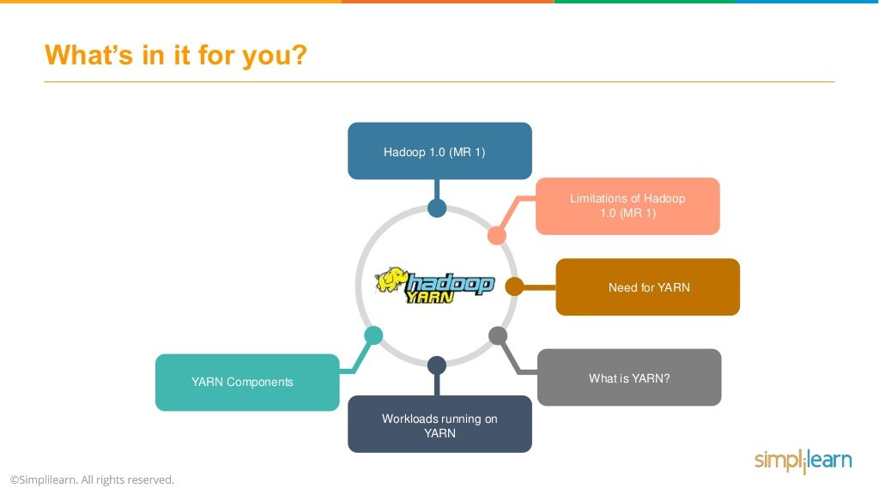

Slide 8
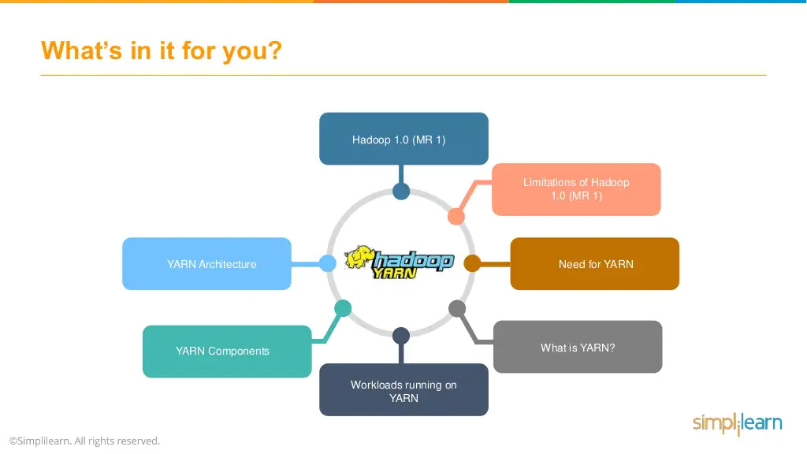

Slide 9
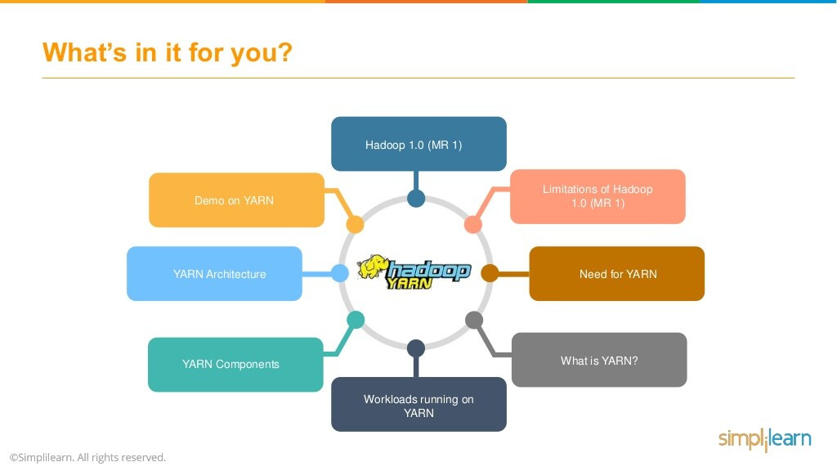

Slide 10


Slide 11
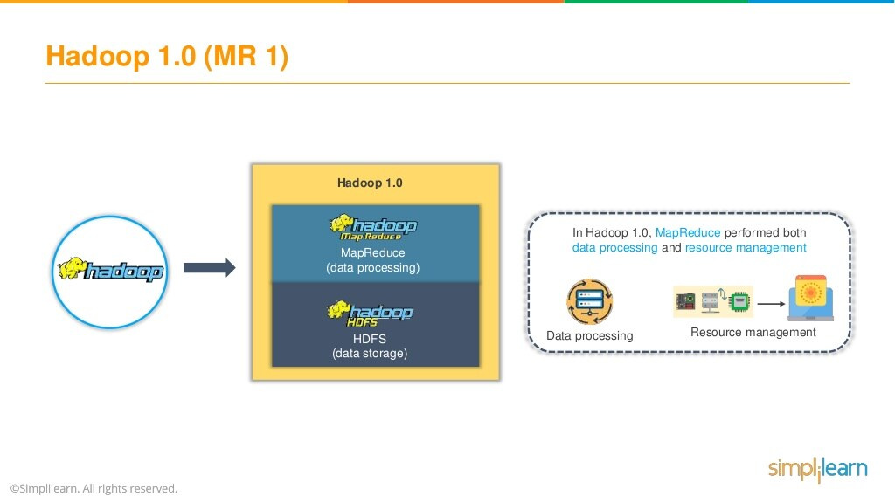

Slide 12
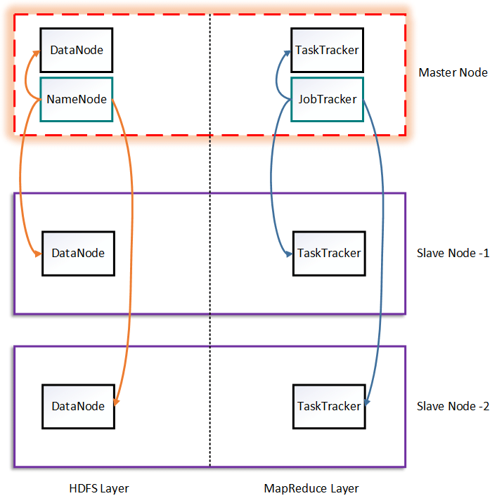
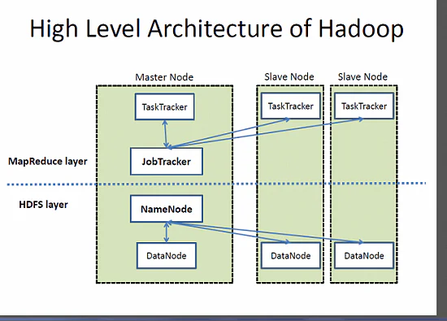

Slide 13
Job Tracker and Task Tracker
Job Tracker and Task Tracker are two essential processes involved in MapReduce execution in MRv1 (or Hadoop version 1).
Both processes are now deprecated in MRv2 (or Hadoop version 2) and replaced by Resource Manager, Application Master and Node Manager Daemons.

Slide 14
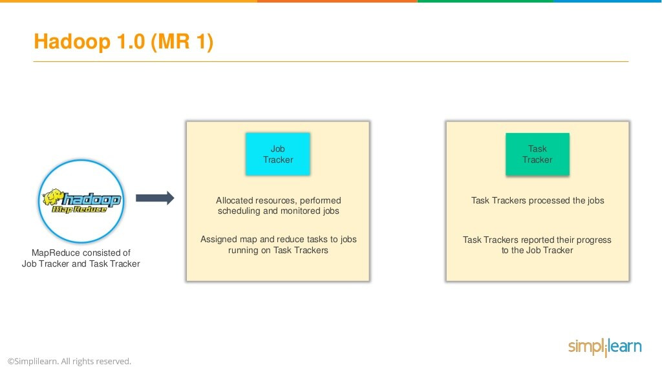

Slide 15
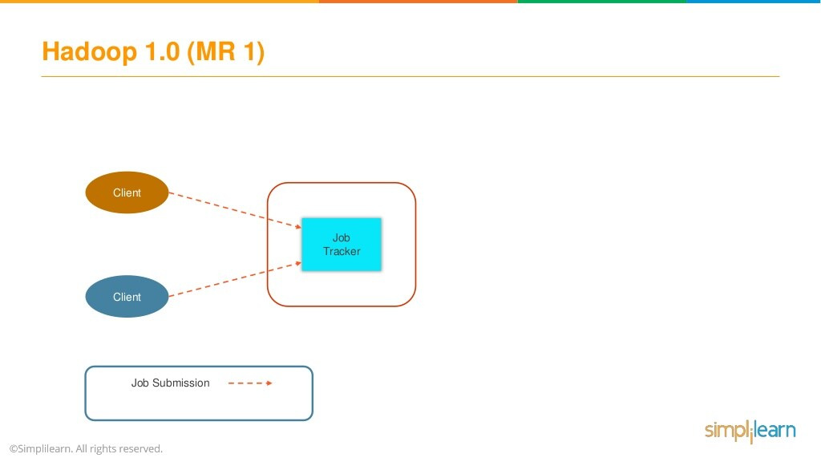

Slide 16
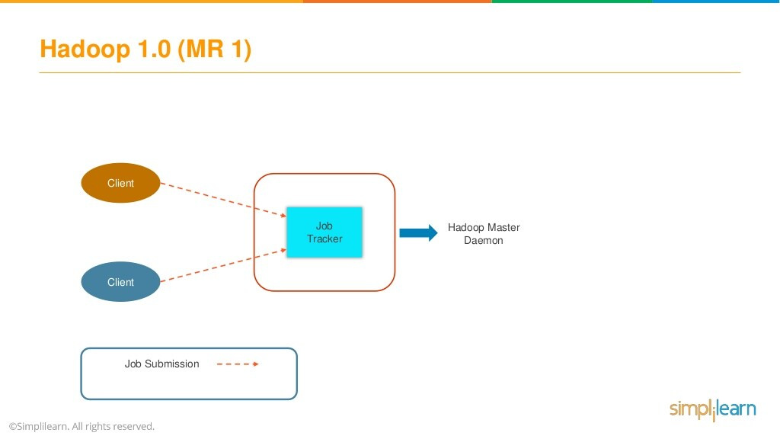

Slide 17
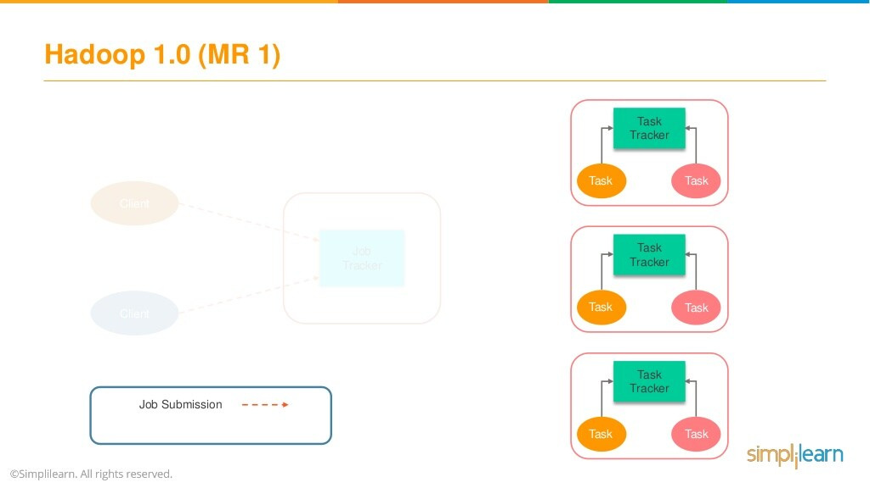

Slide 18
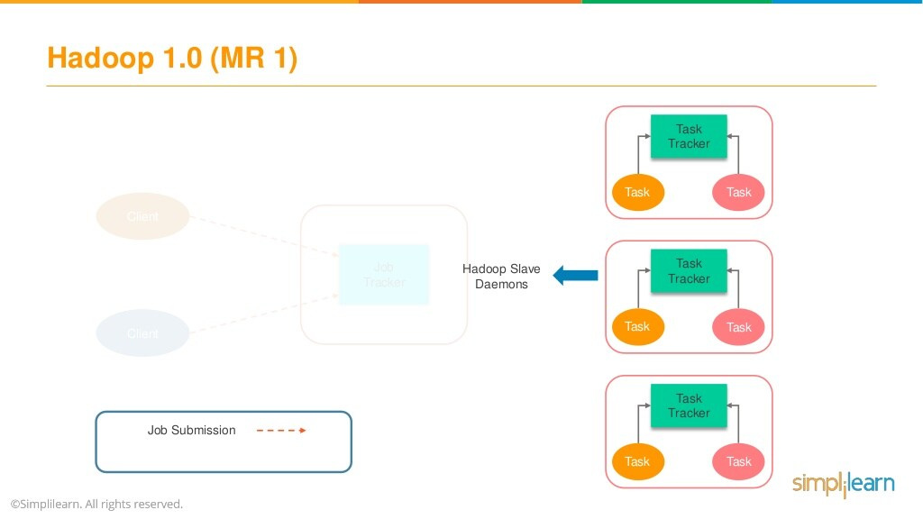

Slide 19
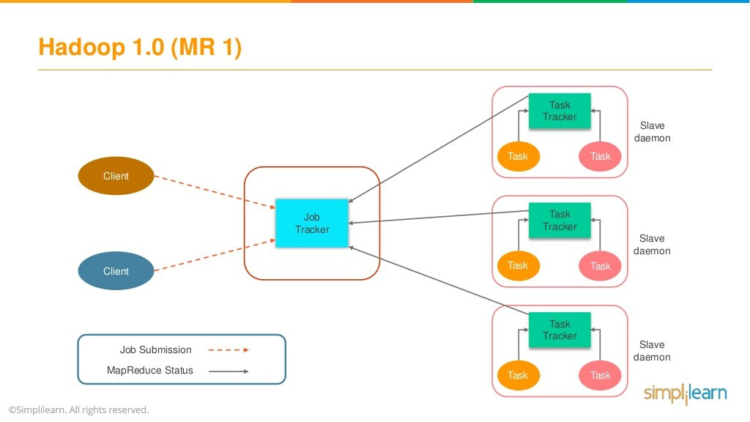

Slide 20
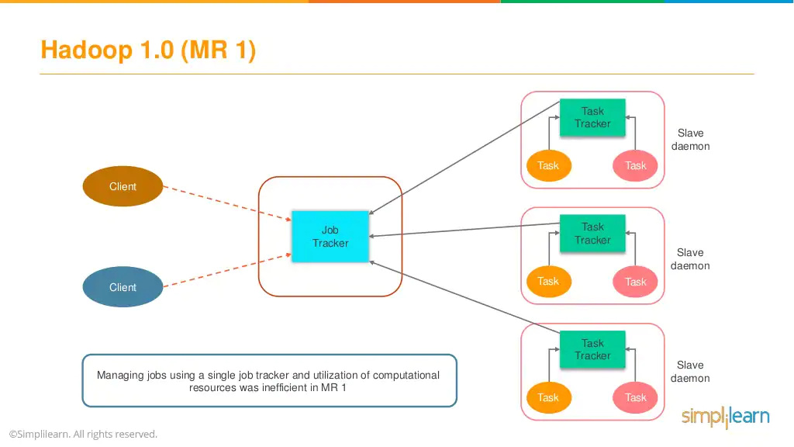

Slide 21
Job Tracker
Job Tracker process runs on a separate node and not usually on a Data Node.
Job Tracker is an essential Daemon for MapReduce execution in MRv1. It is replaced by Resource Manager/Application Master in MRv2.
Job Tracker receives the requests for MapReduce execution from the client.
Job Tracker talks to the Name Node to determine the location of the data.
Job Tracker finds the best Task Tracker nodes to execute tasks based on the data locality (proximity of the data) and the available slots to execute a task on a given node.

Slide 22
Job Tracker
Job Tracker monitors the individual Task Trackers and submits back the overall status of the job back to the client.
Job Tracker process is critical to the Hadoop cluster in terms of MapReduce execution.
When the Job Tracker is down, HDFS will still be functional but the MapReduce execution can not be started and the existing MapReduce jobs will be halted.

Slide 23
Task Tracker
Task Tracker runs on Data Node. Mostly on all Data Nodes.
Task Tracker is replaced by Node Manager in MRv2.
Mapper and Reducer tasks are executed on Data Nodes administered by Task Trackers.
Task Trackers will be assigned Mapper and Reducer tasks to execute by Job Tracker.
Task Tracker will be in constant communication with the Job Tracker signaling the progress of the task in execution.
Task Tracker failure is not considered fatal. When a Task Tracker becomes unresponsive, Job Tracker will assign the task executed by the Task Tracker to another node.

Slide 24
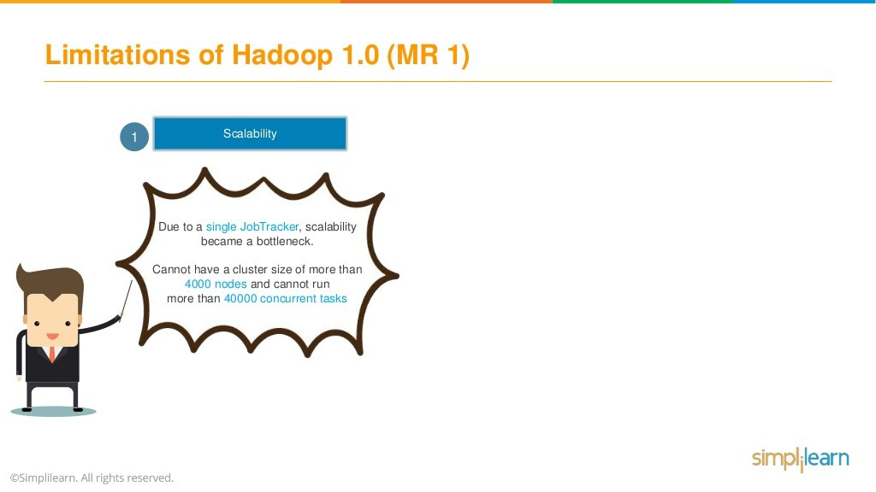

Slide 25
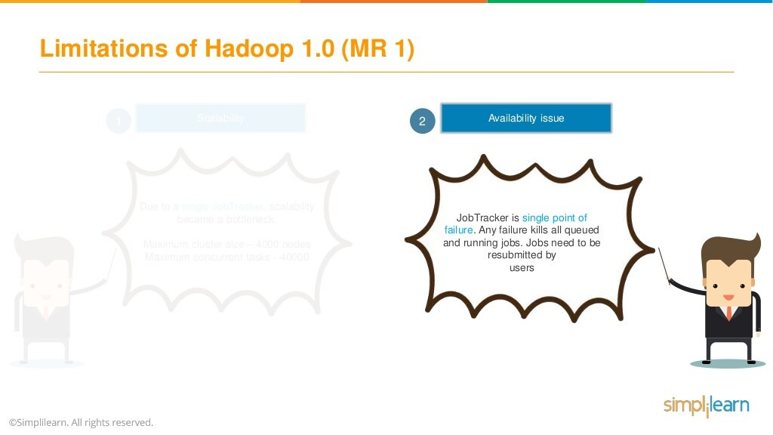

Slide 26
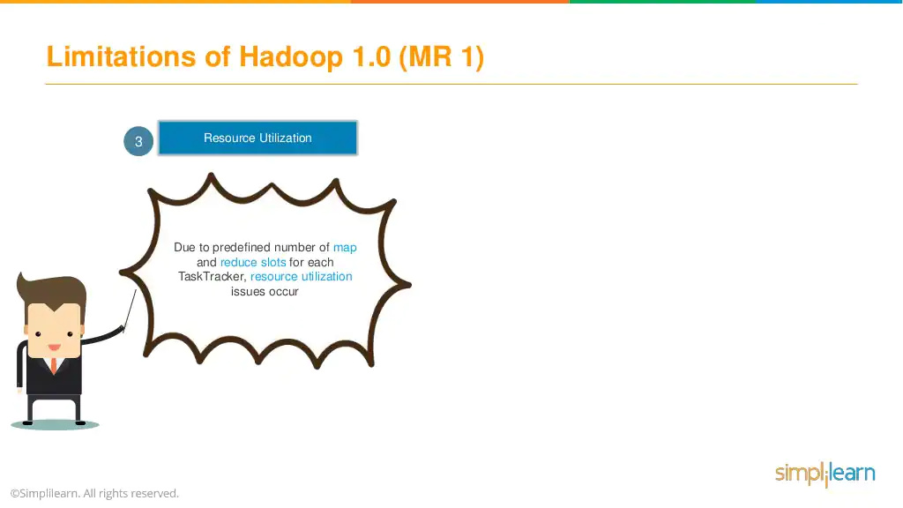

Slide 27
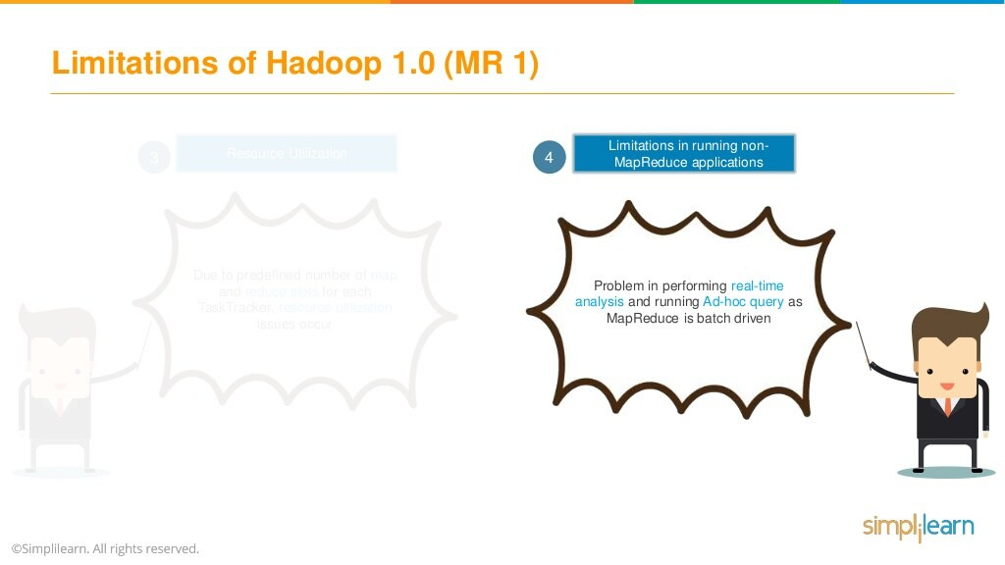

Slide 28


Slide 29
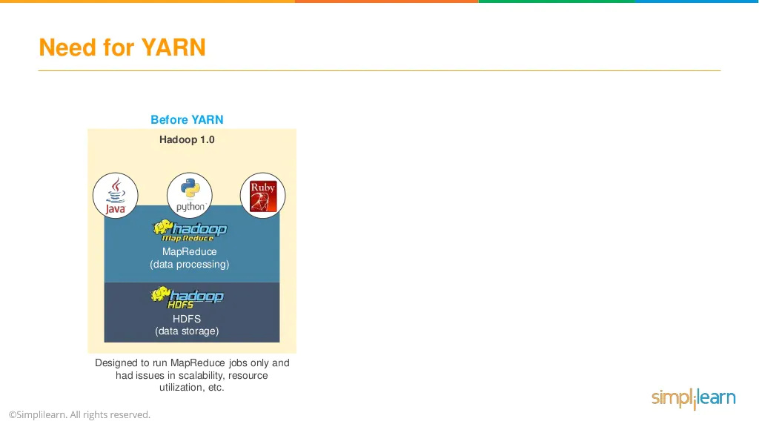

Slide 30
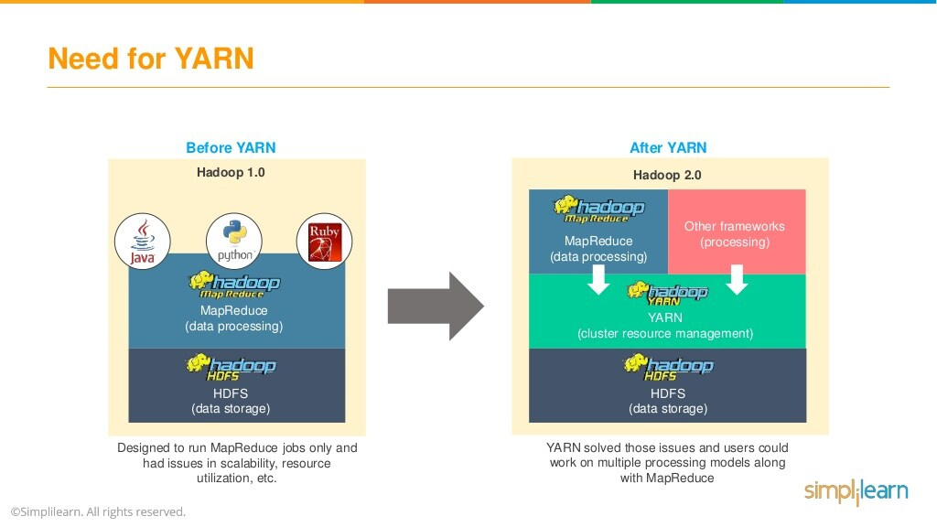

Slide 31
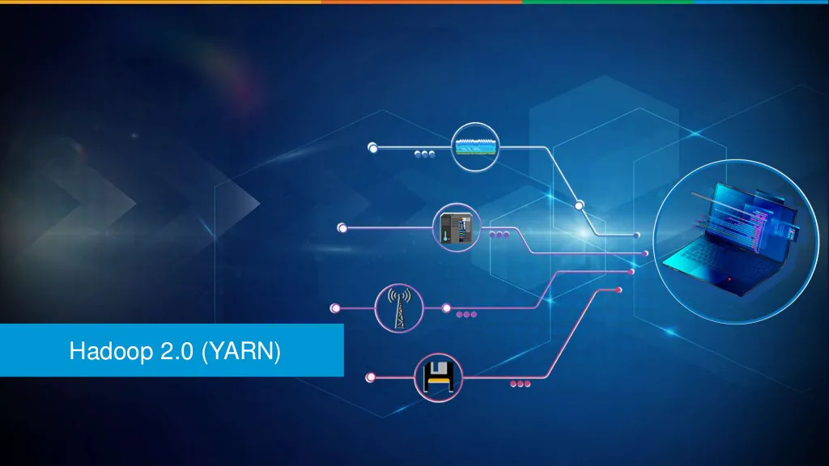

Slide 32
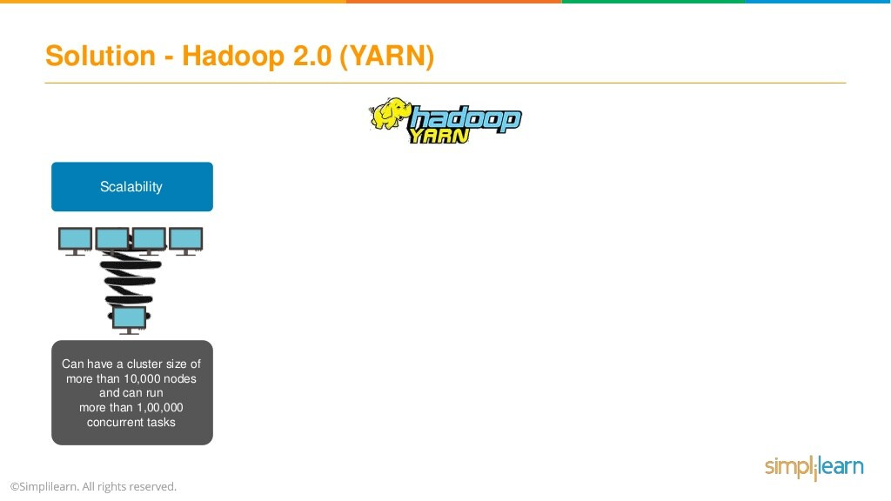

Slide 33
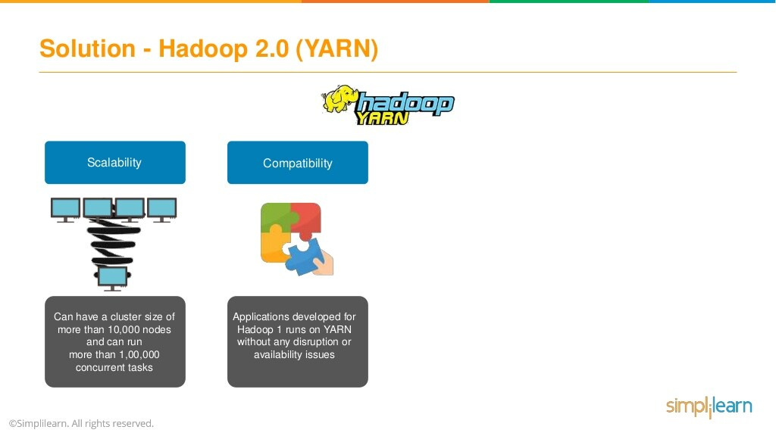

Slide 34
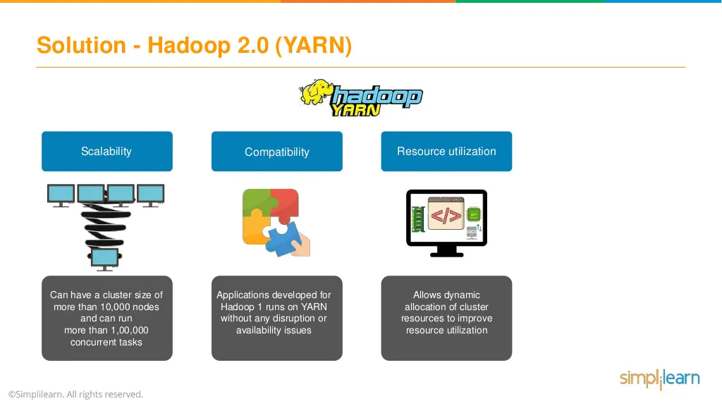

Slide 35
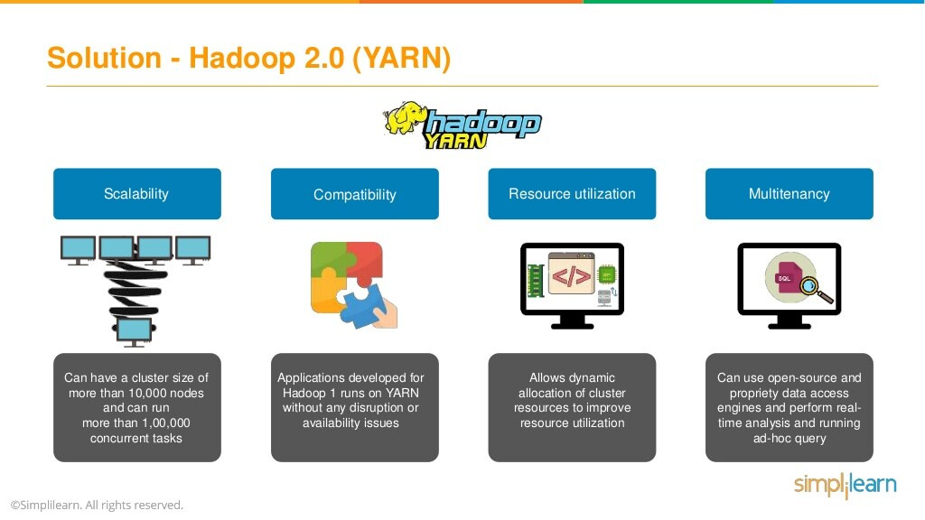

Slide 36


Slide 37
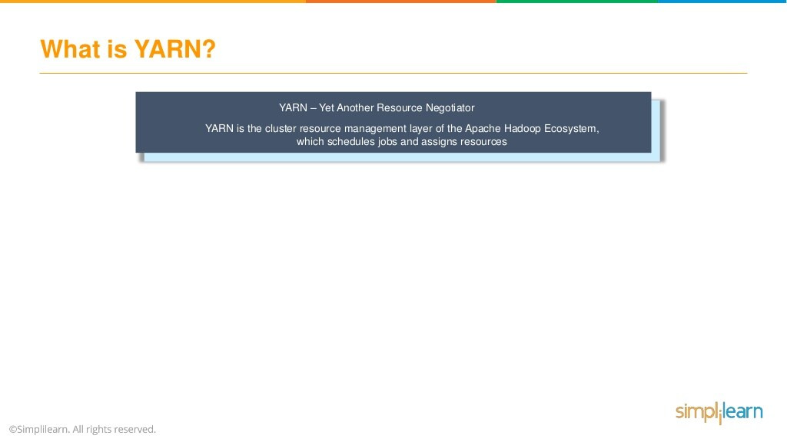

Slide 38
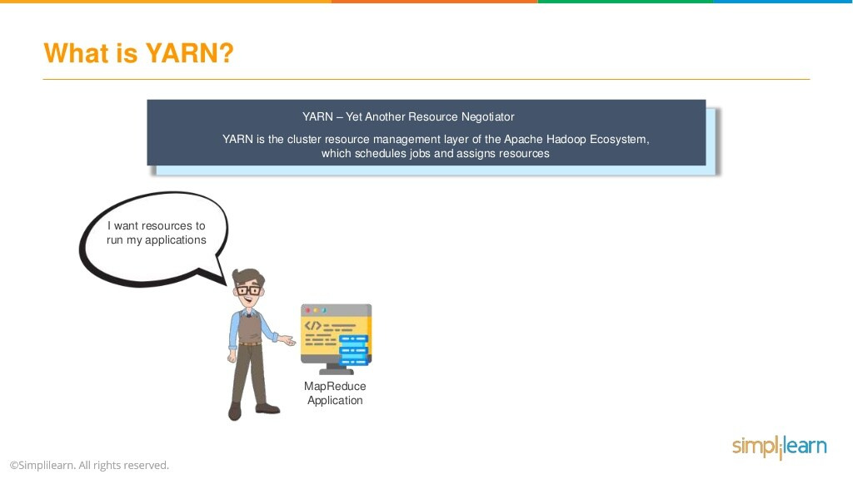

Slide 39
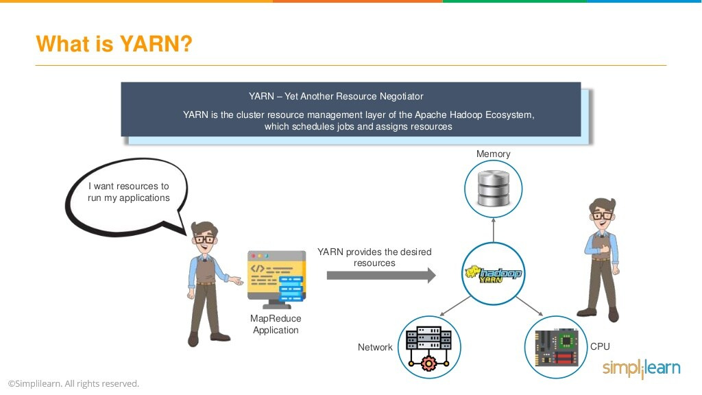

Slide 40
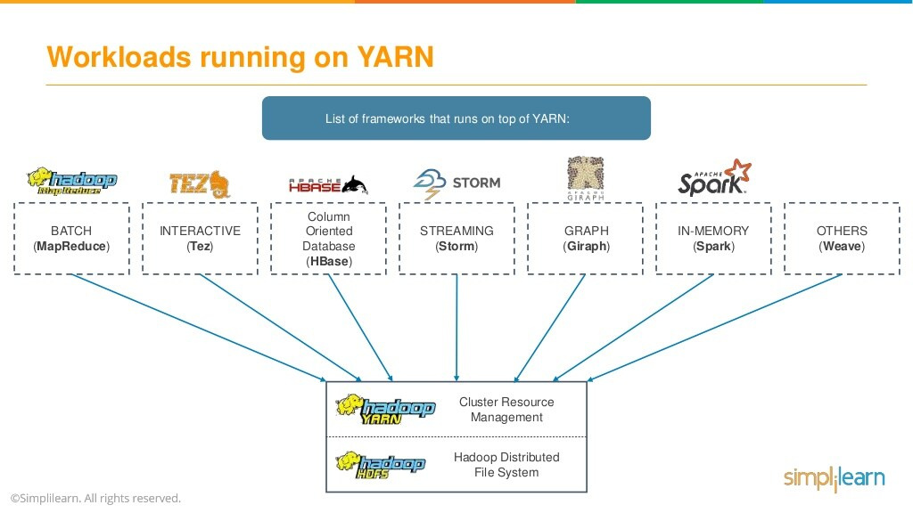

Slide 41


Slide 42
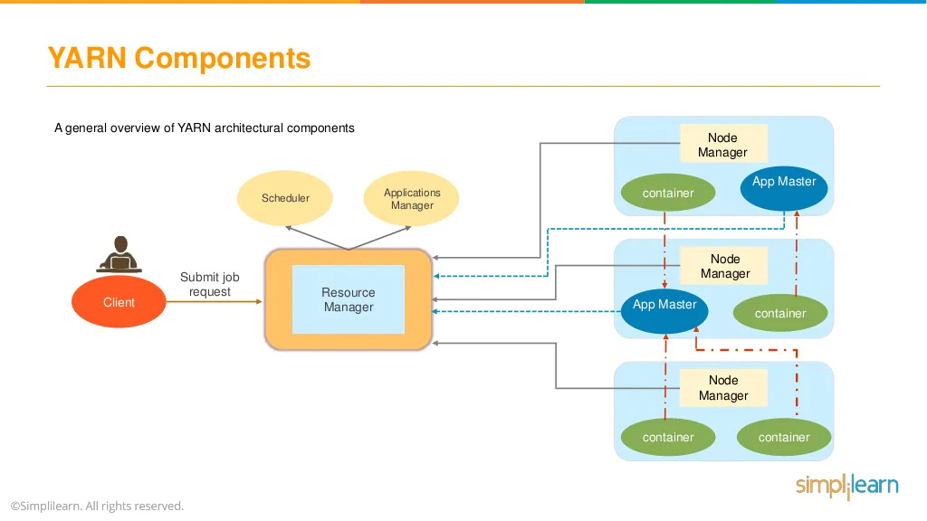

Slide 43
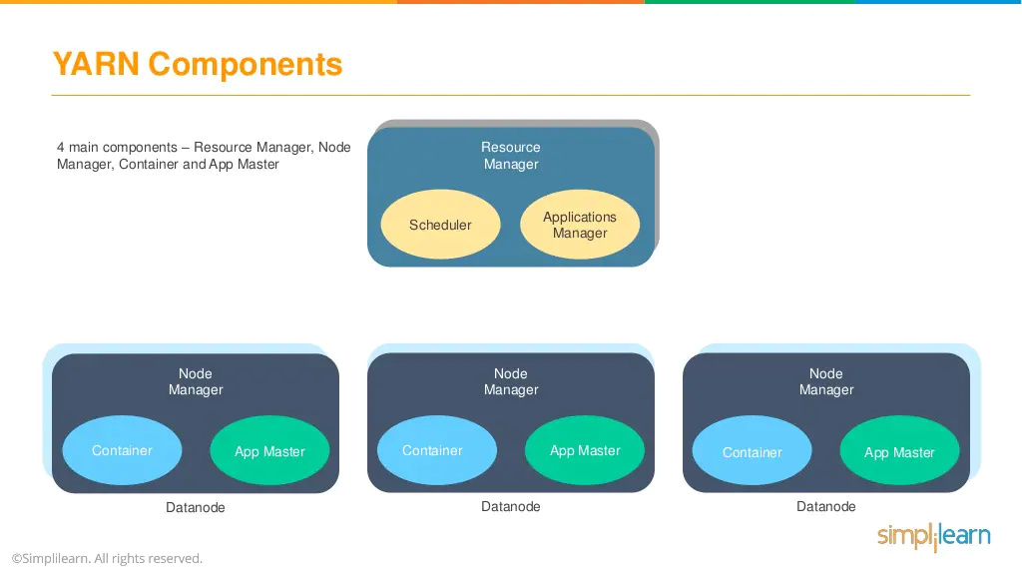

Slide 44
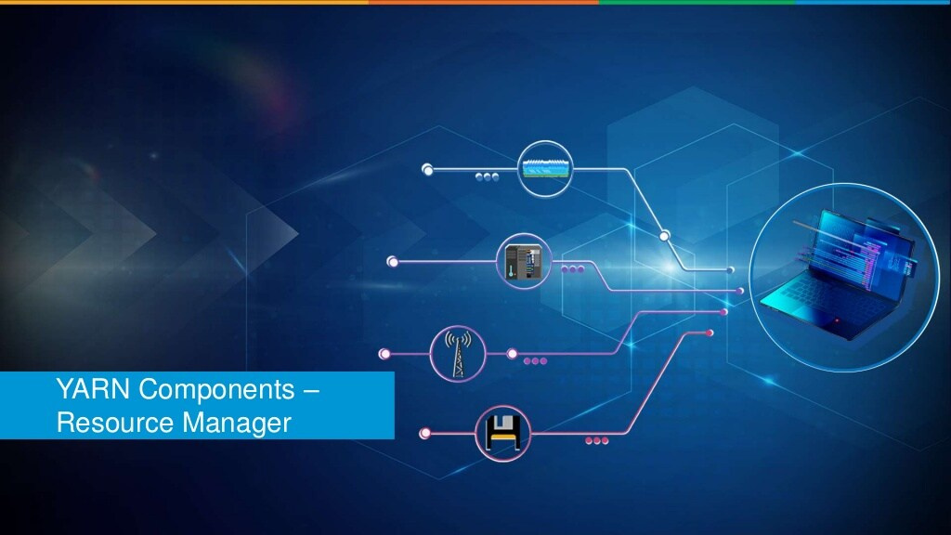

Slide 45
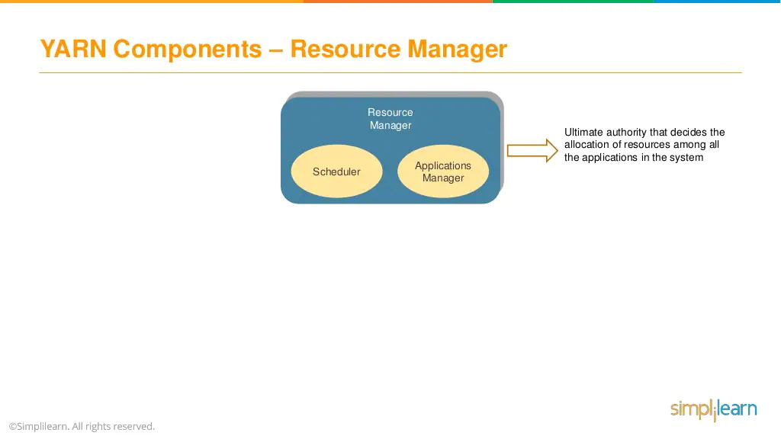

Slide 46
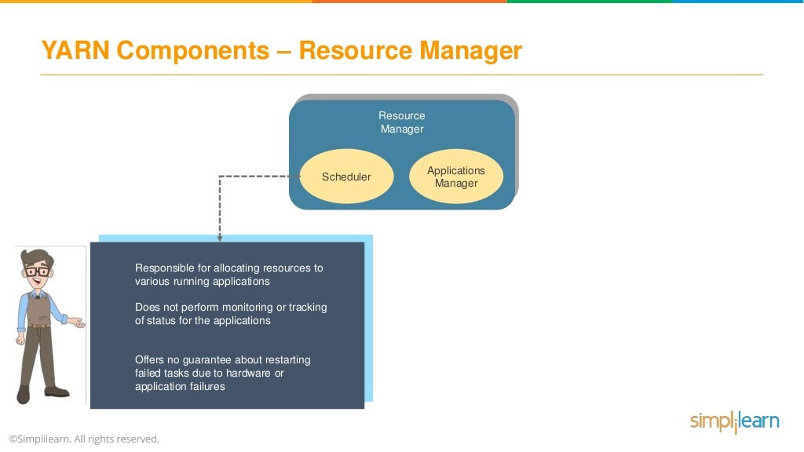

Slide 47
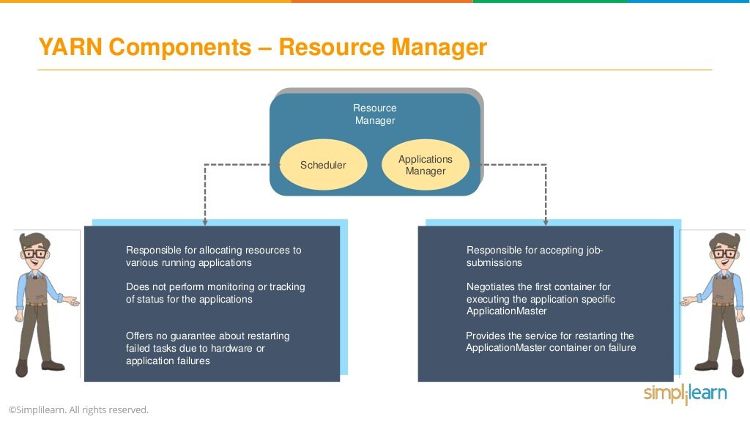

Slide 48


Slide 49
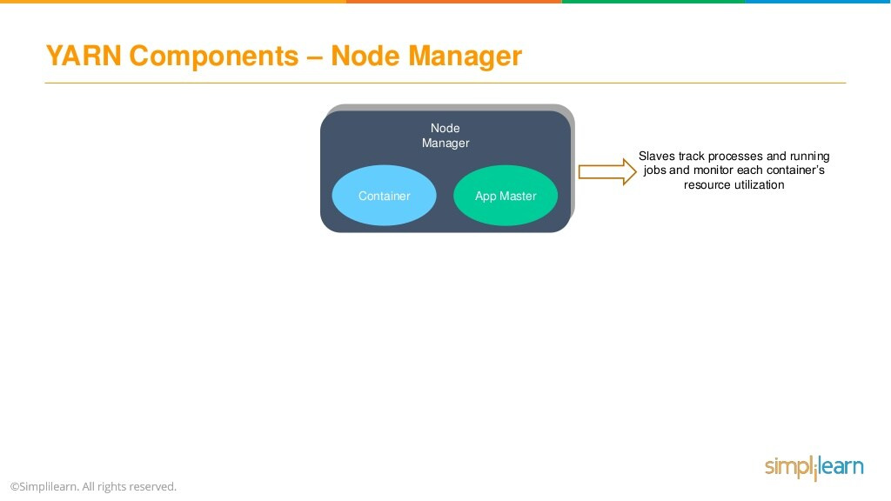

Slide 50
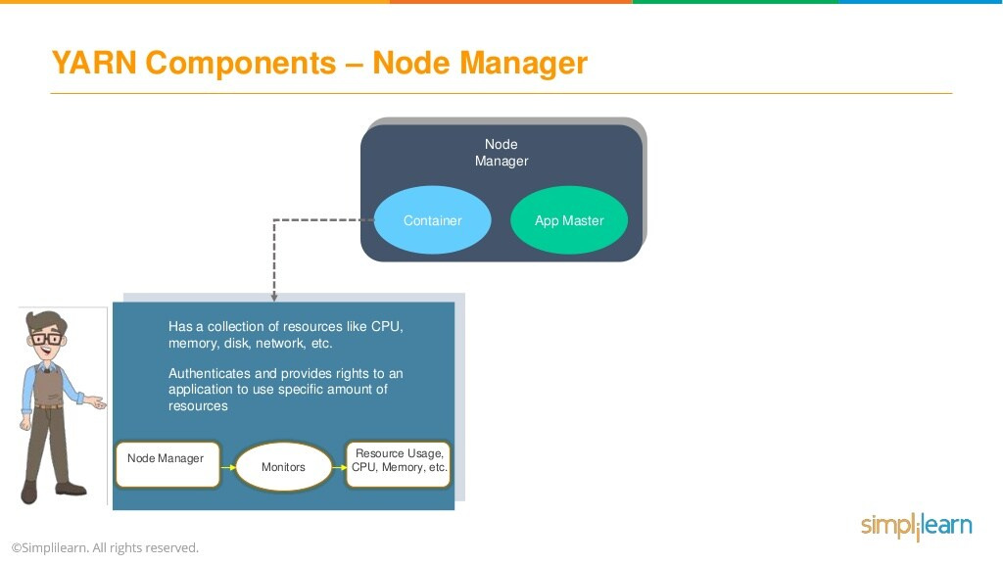

Slide 51
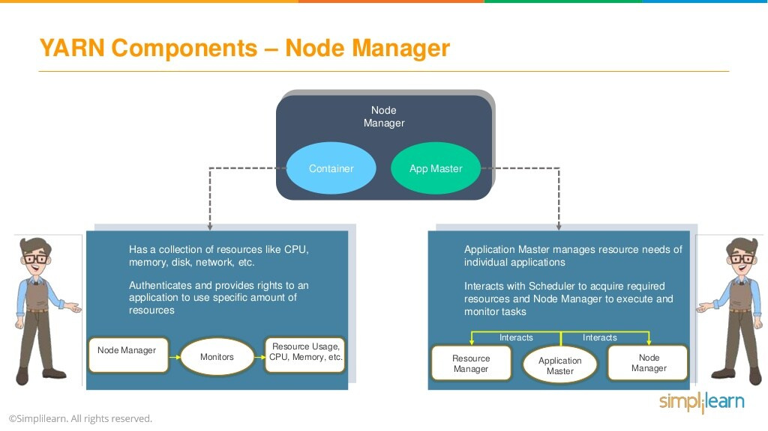

Slide 52


Slide 53
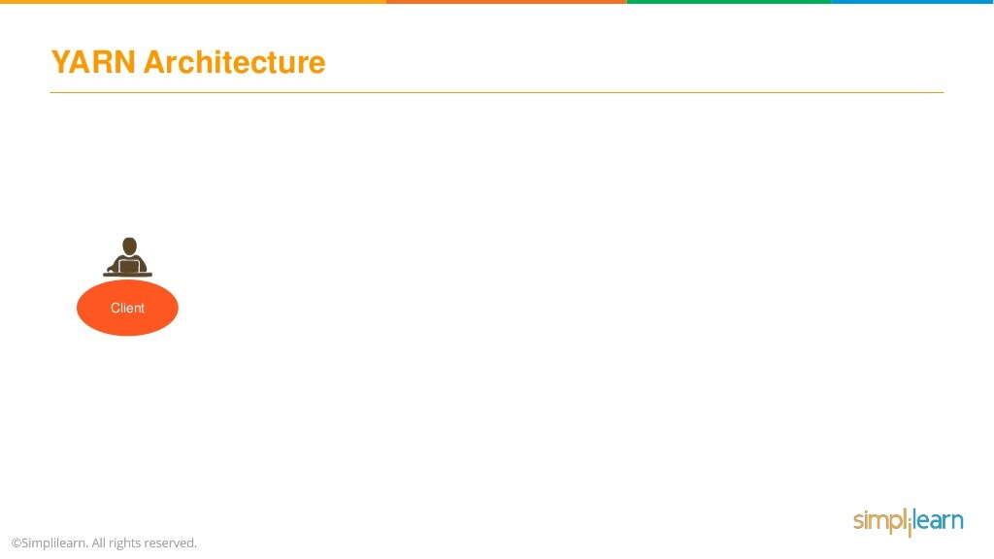

Slide 54
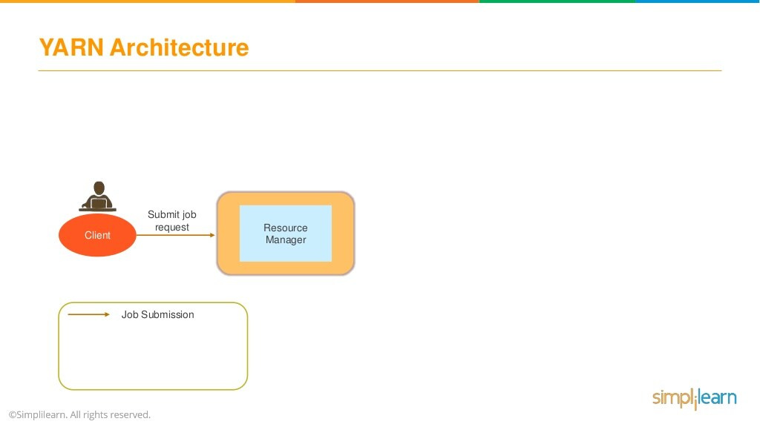

Slide 55
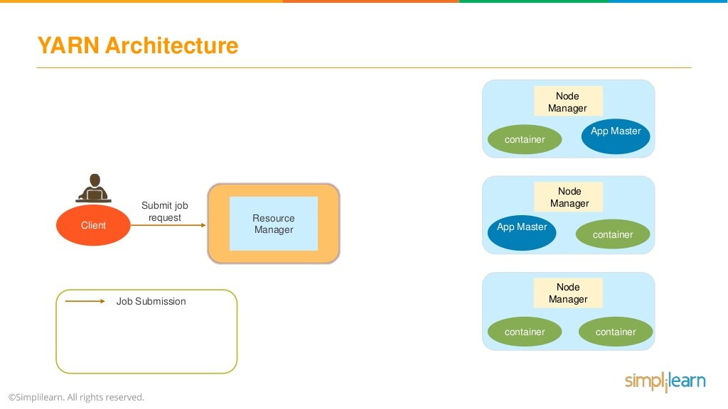

Slide 56
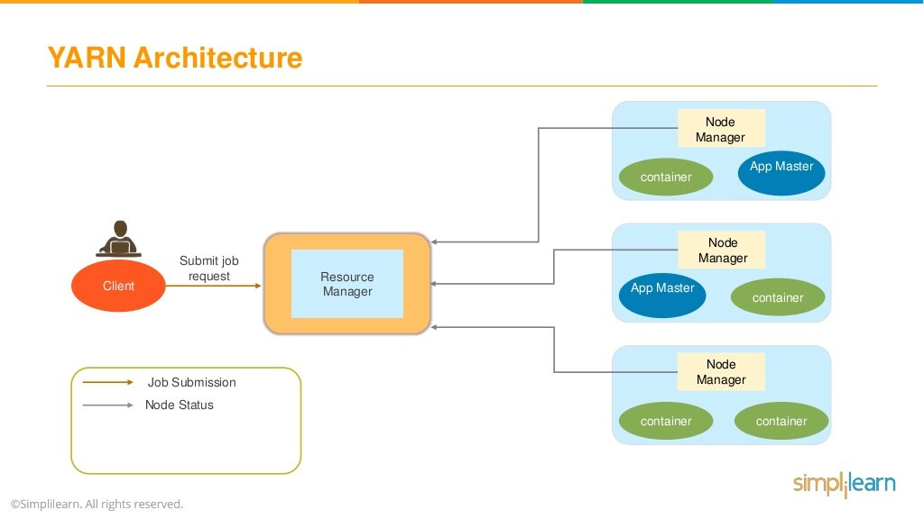

Slide 57


Slide 58
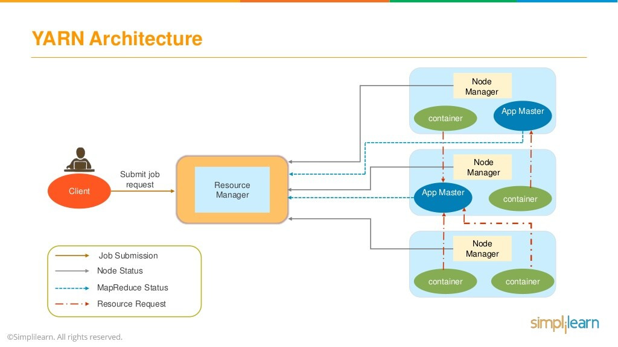

Slide 59


Slide 60
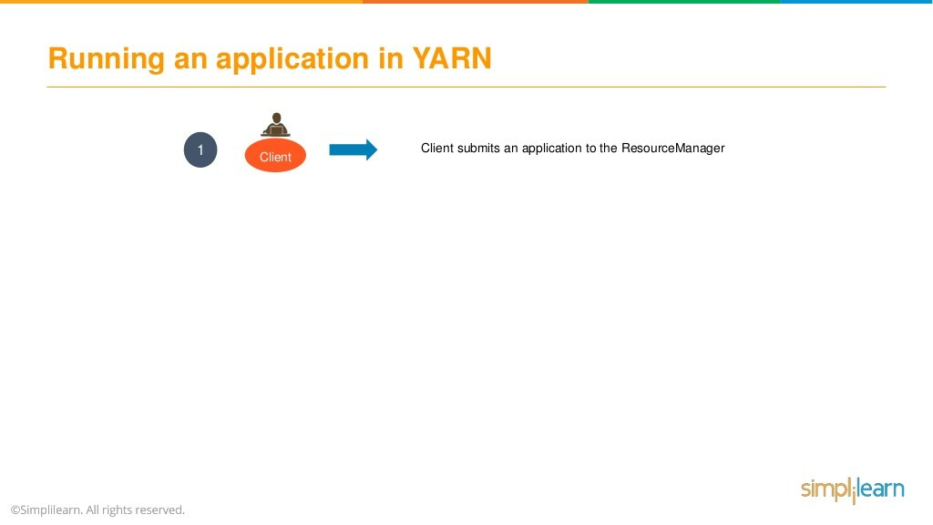

Slide 61
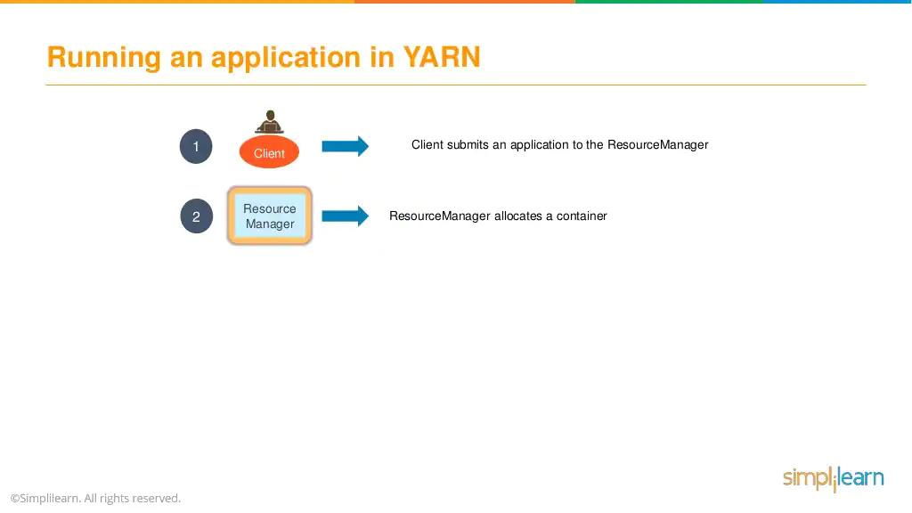

Slide 62
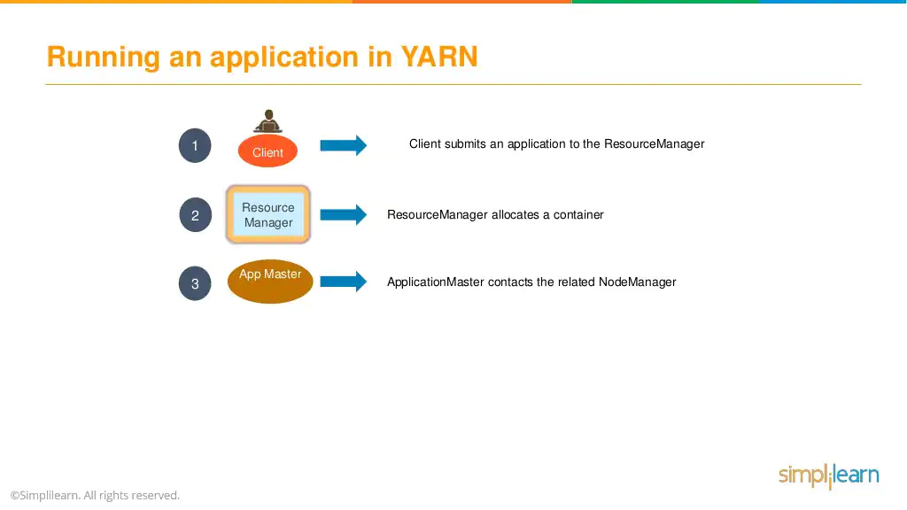

Slide 63


Slide 64


Slide 65


Slide 66


